Slide 1
Notes for the teachers not for the students.
Dear colleagues,
I hope all of you are well by the grace of Allah. I have made this content on the request of Md. Jahangir Alam, Asst. Teacher, Begum Nurjahan Memorial Girls’ High School, Mohammadpur, Dhaka. Tense is the basic of all grammars. I have only shown the main focusing on this content about tense. I have to make another content on tense in details. Before present it in the class please read the instructions below the slides. If you find any lacking, recover it yourself. In case of any inquiry please call me in 01717220115.
Yours Hasan Cambrian
Notes:
Please follow the instruction in this option before going to present the content in the class.

Slide 2


Notes:
Welcome slide. Teacher may change it.

Slide 3

Introduction
Md. Hasan Hafizur Rahman
Cambrian School & College
Baridhara, Dhaka
Presentation made for
Class VI-IX
English 2nd Paper
Grammar

Slide 4
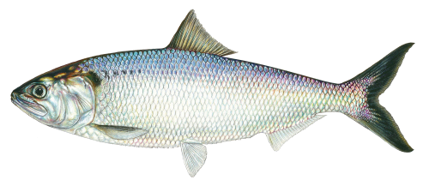
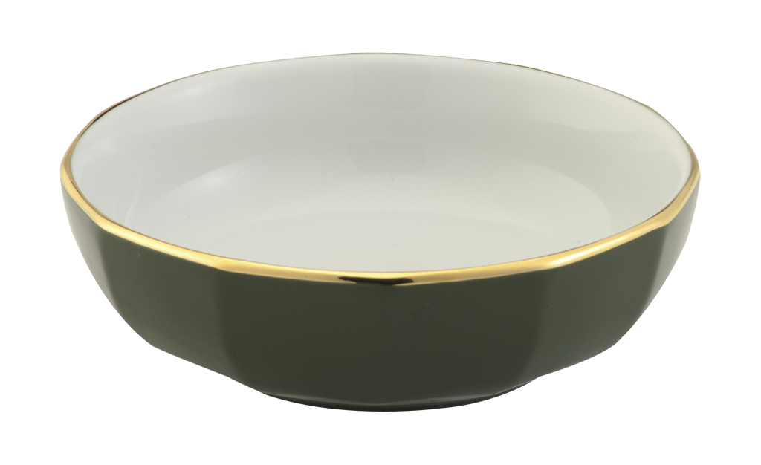
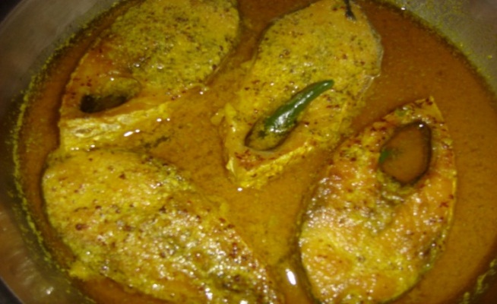

What do you mean?
Present condition
Back
Next
What are these related to?
Notes:
Suspension to advance lesson declaration.

Slide 5
Tense
and it is our today’s lesson .
Notes:
Lesson declaration.

Slide 6
Learning outcomes
At the end of the lesson, we will be able to---
define tense
identify the classification of tenses
identify the definition of three main tenses
identify the basic form of all tenses
identify the forms of tenses in different sentences.
Notes:
All the above learning outcomes will be achieved in this content.

Slide 7
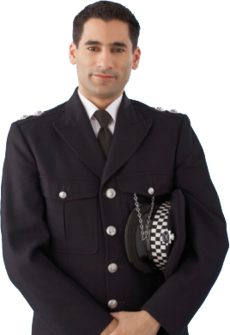


He will be an officer in future.
Now he is going to university.
The baby played at his early age.
What is tense?
Notes:
Leading to the definition of tense.

Slide 8
Follow
All the three verbs are functioning
on
Indicates past
played
Indicates present
is going
Indicates future
times.
will be
So, tense is called the time of verbs.
Notes:
Definition of tense with the function of verbs. Focusing Learning Outcomes No.1

Slide 9
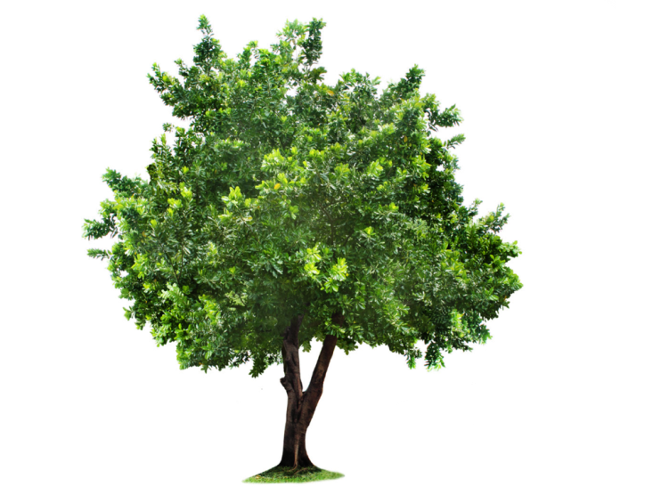
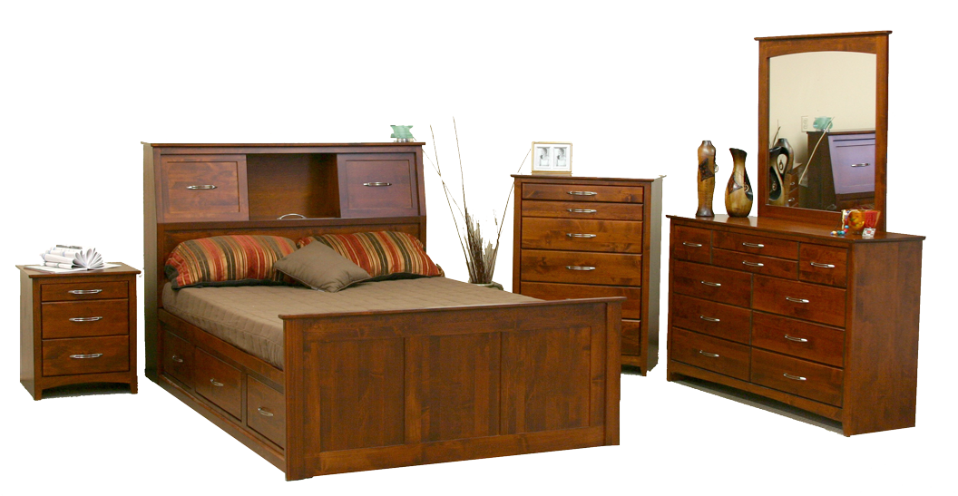
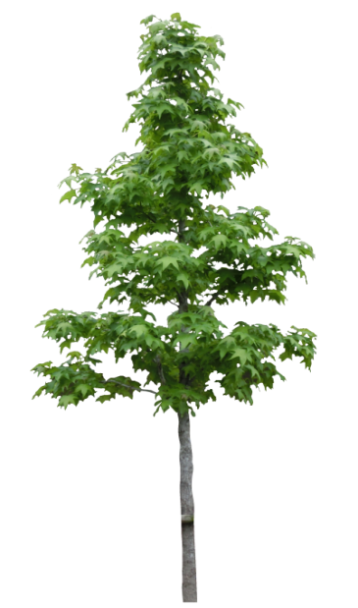
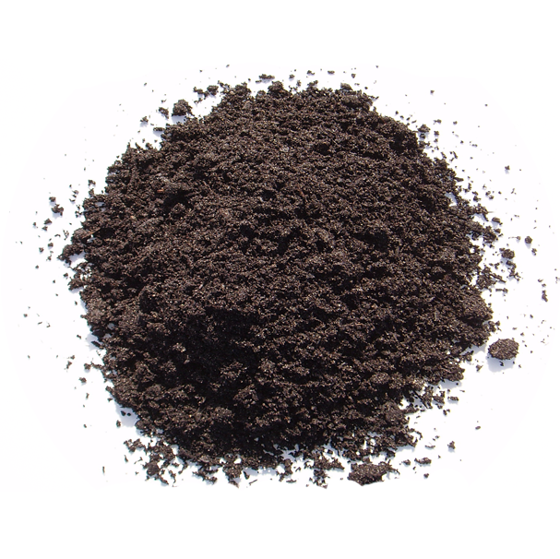
According to the function of time, tenses are divided into three kinds.
Past
Present
Future
Notes:
Classifications of tenses. Focusing Learning Outcomes No.2

Slide 10
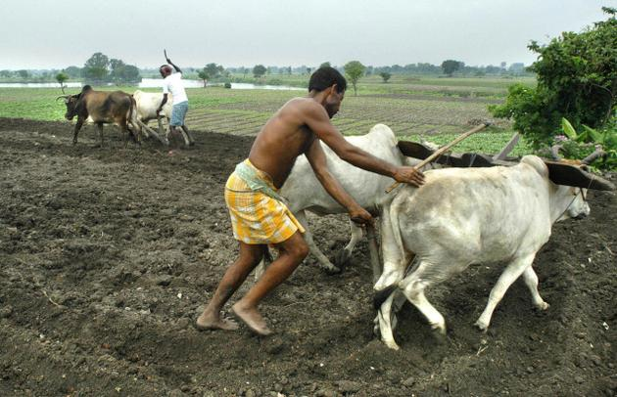
Past tense
We cultivated land with
wooden plough and bullocks.
cultivated
Past form of verb
The verb that indicates something past is called a past tense.
Notes:
Definition of past tense with example. Focusing Learning Outcomes No.3

Slide 11
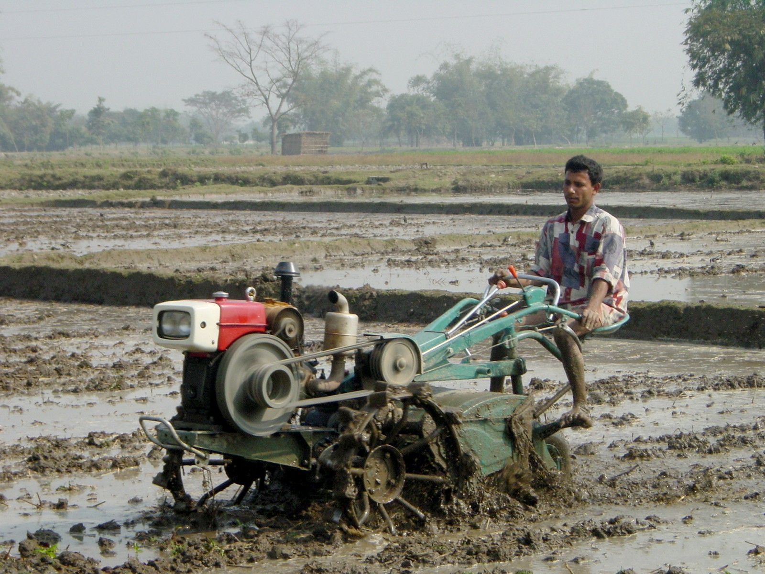
Present tense
We cultivate our lands with tractor now.
cultivate
Present form of verb
The verb that indicates something present is called a present tense.
Notes:
Definition of present tense with example. Focusing Learning Outcomes No.3

Slide 12
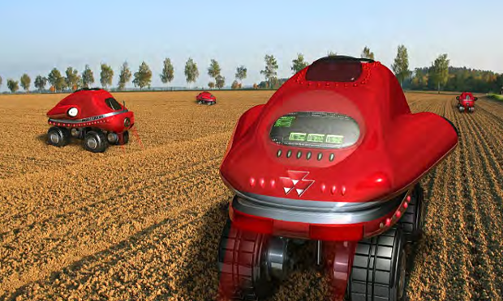

Future tense
We will cultivate our lands with driverless tractor.
will cultivate
future form of verb
The verb that indicates something about future is called a future tense.
Notes:
Definition of Future tense with example. Focusing Learning Outcomes No.3

Slide 13

There are four forms of all the three tenses.
Sl# | Past | Present | Future
1. | Past form of verb – was/were /had &V₂ | Present form of verb-am/is/are/have/has &V₁ (s/es) | Will be / will +V₁
2. | was/were + Verb (ing) | am/is/are +verb (ing) | will be +verb (ing)
3. | had +V₃ | have/has +V₃ | will have +V₃
4. | had been + verb (ing) | have/has been + verb (ing) | will have been + verb (ing)
Name of the forms
Indefinite
Continuous
Perfect
Perfect continuous
Notes:
V₁ stands for verb present form, V₂ stands for verb past form, V₃ stands for verb perfect form. Recently V₄ is meant ‘ing’ with verb. This slide contains the basics of all tenses and their forms. If a student can learn it well, it is sufficient for him to learn tenses. Learning outcomes No-4 is focused here.

Slide 14
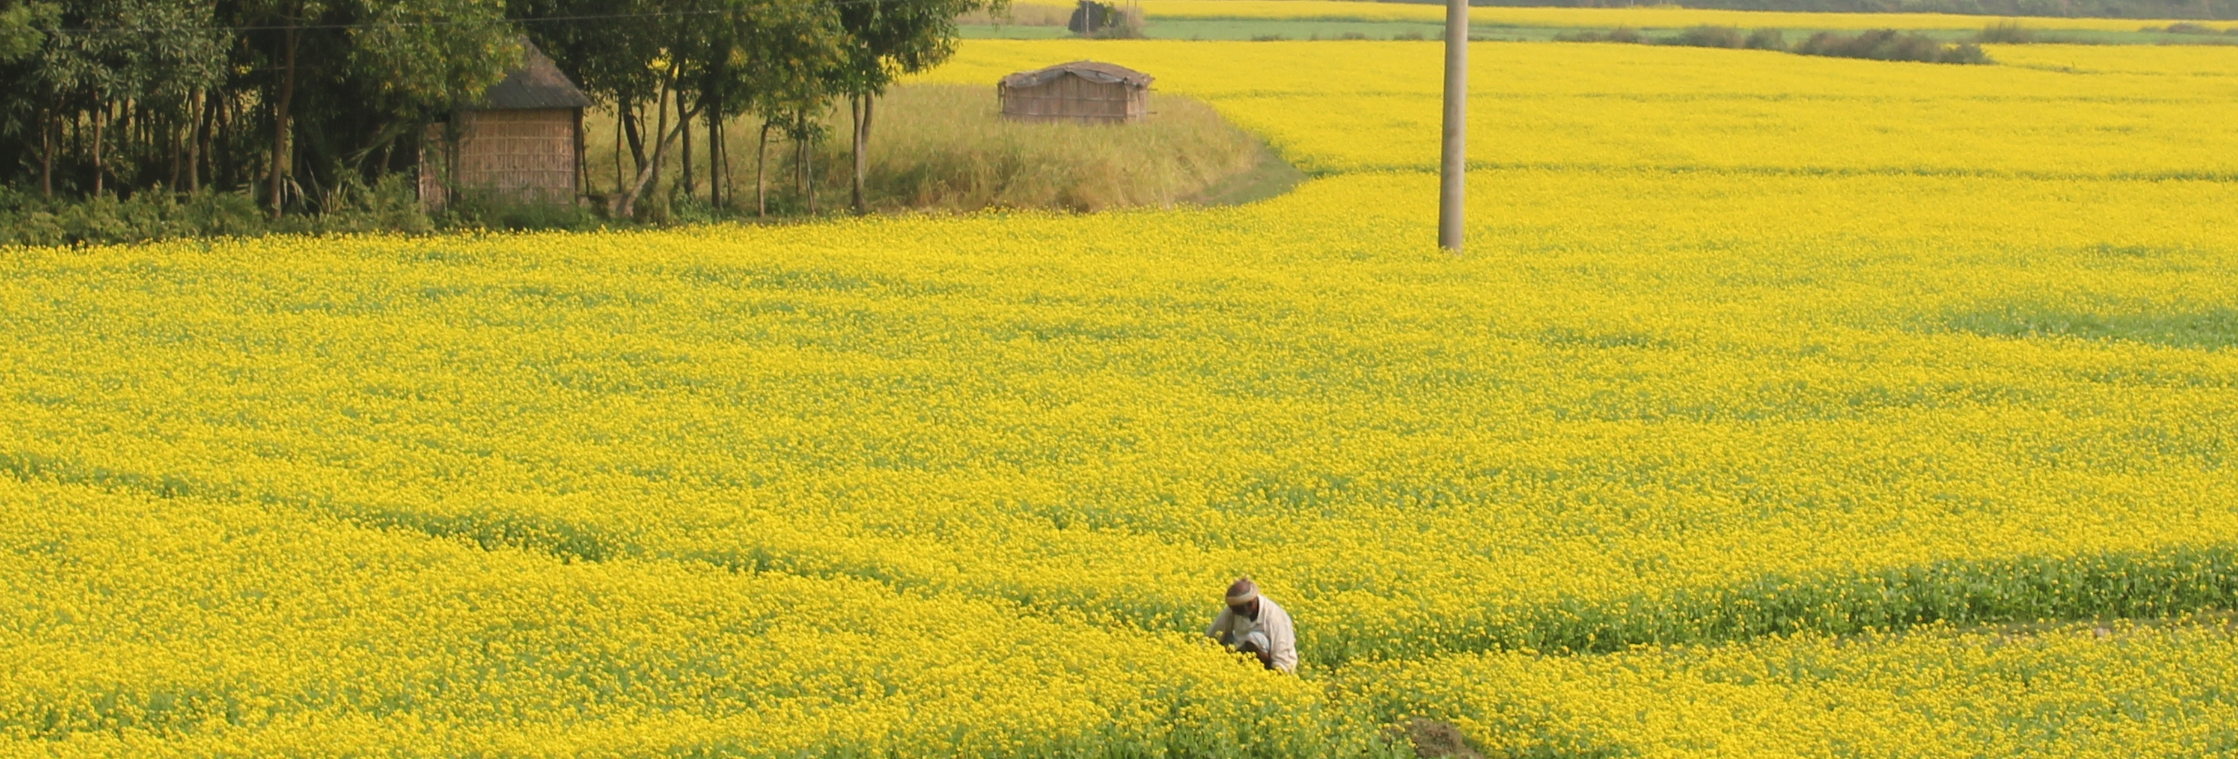
Pair Work
Identify the name and forms of the tenses.
The field looks very charming.
There was a hut at the corner of the field.
The farmer will get a good harvest.
He is working in the field.
He has a good hope of his future.
He was preparing his land well.
He has cleaned the weeds from his field.
He has been working in his field for a long time.
He had given fertilizer in his field properly.
He will have been happy with his crops.
Notes:
Evaluation/Feed back. Learning outcomes No-5 will be focused.

Slide 15
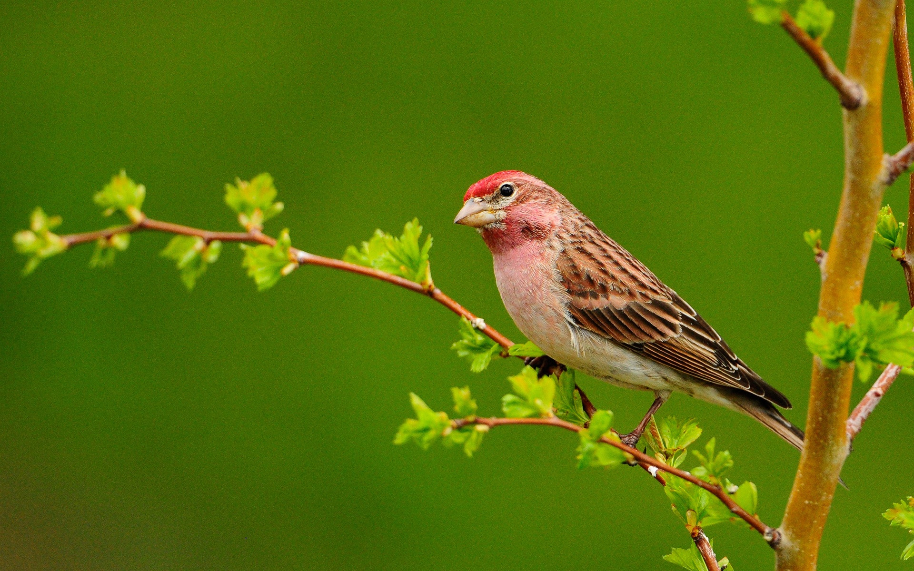
Thank you
Continue to next content on tense in details.
Notes:
Ending slide.

